Slide 1
Integer Value Optimization
Dr. Siddhartha Agarwal
MND 404
Systems

Slide 2
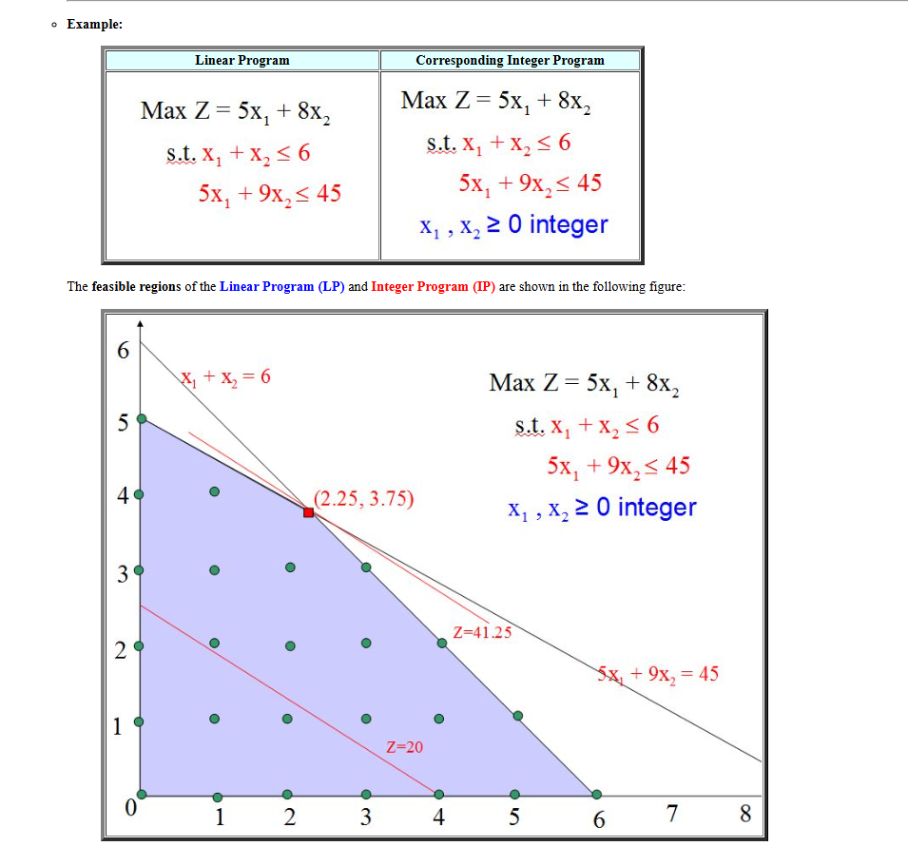

Slide 3
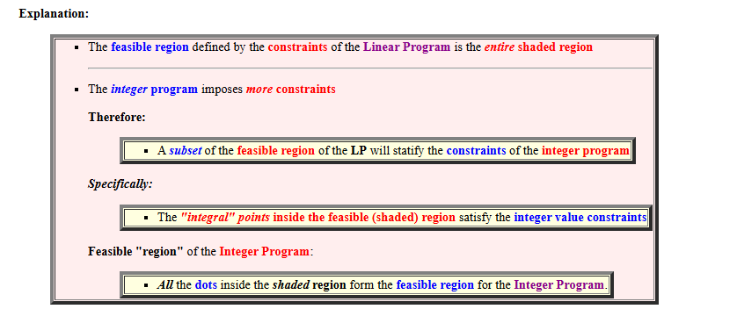

Slide 4
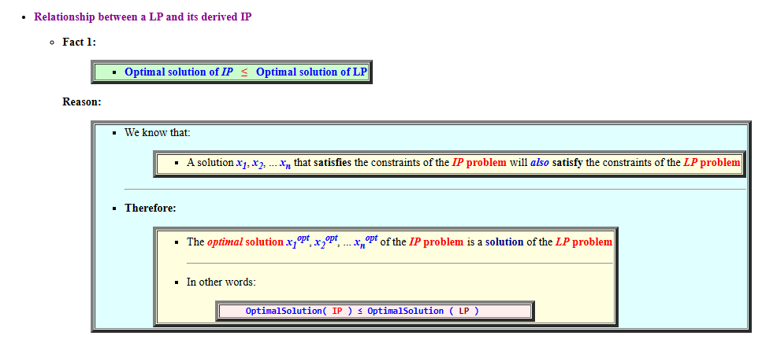
Optimal solution of IP ≤ Optimal solution of LP

Slide 5
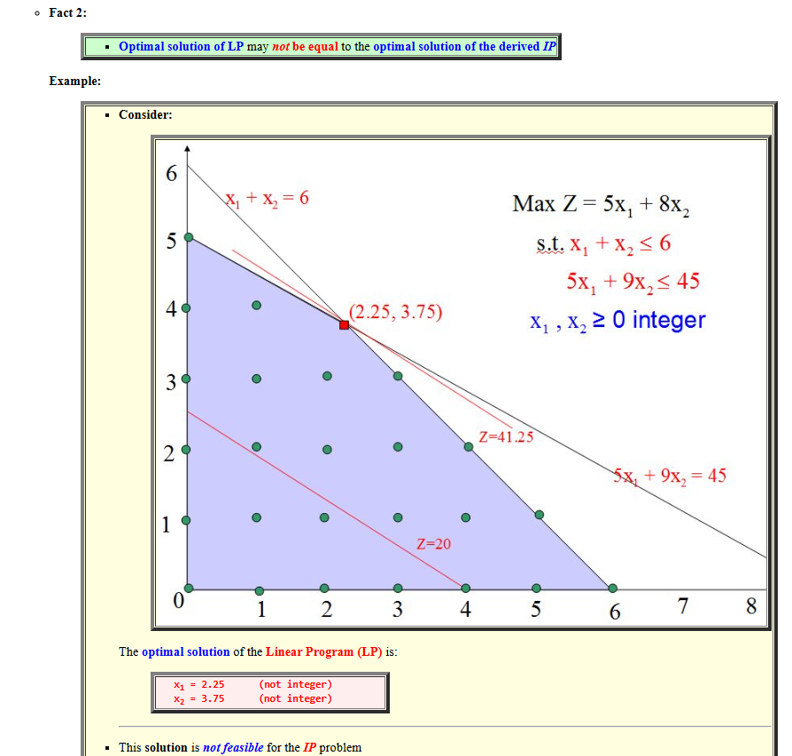
Optimal Solution of IP may not be equal to the Optimal Solotion of LP

Slide 6
IF the optimal solution of LP is integral (= all values are integers), then this solution is also the optimal solution of the derived IP
IF the Linear Program LP is infeasible (i.e., the feasible region is empty), then the Integer Program IP is also infeasible

Slide 7
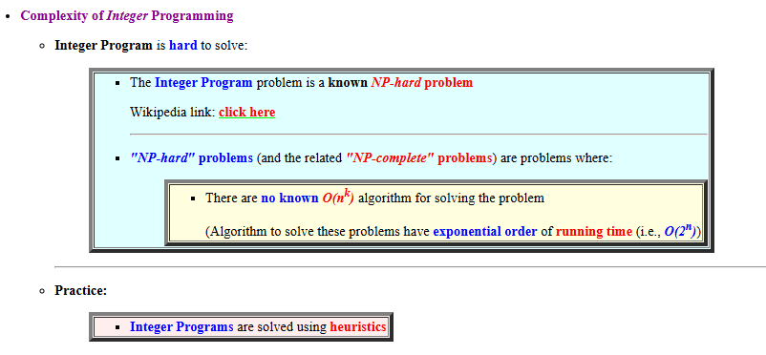

Slide 8
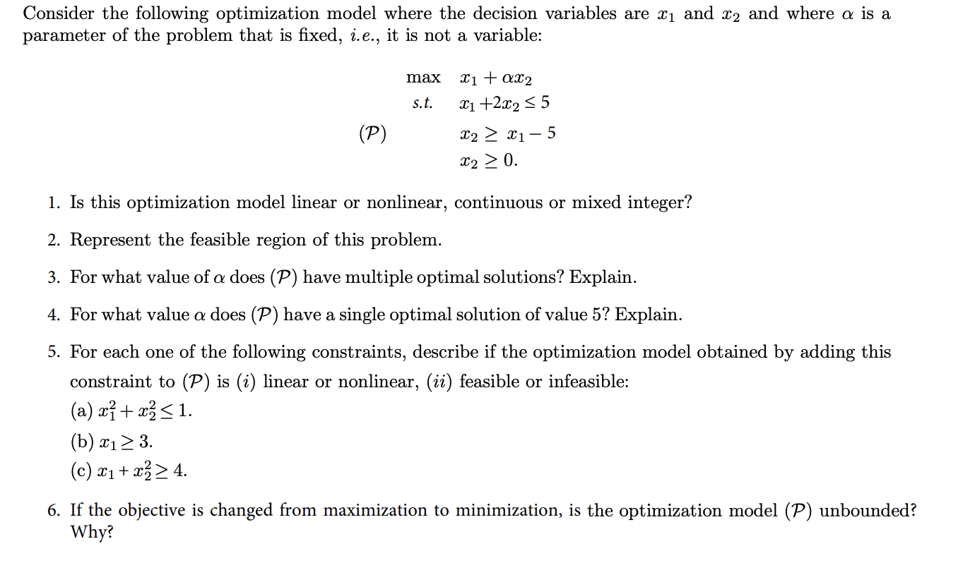
Class Problem

